Slide 1





AUGMENTED REALITY INTERFACES ON USER EXPERIENCE IN HCI
COIS 3560H
HUMAN COMPUTER INTERACTION
Presentation by:
SAMAKSH MONGA 0721348
KRUTARTH GHUGE 0746015

Slide 2




Integration of AR in HCI
Technological progress allows AR interfaces to seamlessly merge digital content with reality for immersive experiences.
Applications: AR revolutionizes different fields like gaming, education, healthcare, and industry, such as the IKEA AR furniture app which improves user interactions.
Assessments: Users typically have positive views of AR interfaces, emphasizing their immersive qualities. Nevertheless, obstacles like device constraints and usability problems continue to exist.
Future Prospects: Augmented reality is set to become widespread, with an emphasis on design principles centered around humans to guarantee inclusivity and ethical interactions. With the advancement of AR technology, user experiences will become even more immersive and seamless in various applications and industries.
ADVANCEMNETS
SAFETY
TIPS

Slide 3



CONTENTS THAT I HAVE FOCUSED IN MY REPORT
LITERATURE
REVIEW
METHODOLOGY
RESULTS
The Future of Augmented Reality in HCI
Challenges and Opportunities
Augmented Reality in HCI: Current State

Slide 4



INTRODUCTION
In the fast-changing technology world, Human-Computer Interaction (HCI) is leading the way in developing smooth user experiences. Augmented Reality (AR) interfaces combine digital elements with the physical world to enhance interaction possibilities. Comprehending the influence of AR on User Experience (UX) in HCI is crucial for stimulating innovation and enhancing user contentment.

Slide 5



LITERATURE REVIEW
1. Key Findings on AR Interfaces in HCI.
2. Applications of AR Across Domains
3. Understanding User Behaviors and Preferences

Slide 6


Hyungii Kim investigates how head-up augmented reality interfaces can be utilized in crash warning systems, providing valuable information on user satisfaction and practicality in safety-related uses.
Kangsoo Kim's research delves into how conflicts between physical and virtual elements in augmented reality impact user engagement, revealing challenges in the process.
Lingda Rong's research on navigating with AR on mobile devices delves into different ways of interacting and personal variations, offering useful perspectives on enhancing user-friendliness.
Andreas Riegler's examination of literature and an HCI workshop explore the potential applications of AR in upcoming transportation methods, providing perspectives on evolving patterns and advancements.
Christos Papakostas' study on a mobile AR training system focuses on personalized learning experiences, highlighting the effectiveness of tailored AR content.
KEY FINDINGS ON AR INTERFACES IN HCI

Slide 7
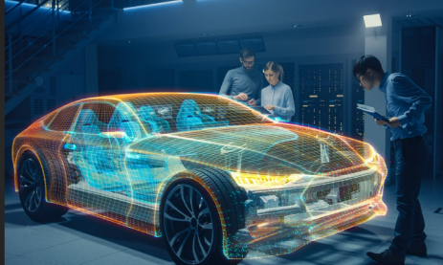
Safety is improved by utilizing AR interfaces in crash warning systems to increase situational awareness and enhance user response times.
Education: Augmented Reality is used to develop interactive learning experiences, enabling improved comprehension and involvement for students.
Mobile AR navigation systems offer users relevant information about their environment, improving functionality and user satisfaction.
Instruction: AR is utilized to provide customized instruction experiences, giving instant guidance and feedback to individuals in different fields.
APPLICATIONS OF AR ACROSS DOMAINS

Slide 8


User research highlights the significance of taking into account personal variations and choices when creating efficient AR interfaces.
Information gained from research guides the design process, ensuring that AR systems are easy to use, interesting, and cater to a variety of user groups.
By comprehending the ways in which users engage with AR interfaces, designers can develop user-centered designs that improve the overall user experience and usability.
UNDERSTANDING USER BEHAVIORS AND PREFERENCES

Slide 9



METHODOLOGY
DATA COLLECTION METHODS
RESEARCH APPROACH
PARTICIPANT SELECTION CRITERIA

Slide 10
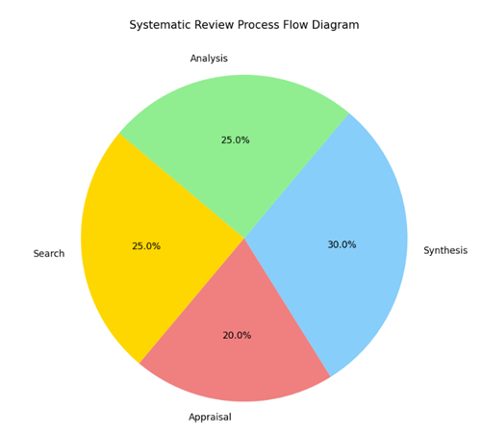
Employed a combination of qualitative and quantitative approaches through a mixed-methods strategy.
Hybrid method selected to thoroughly understand the impact of augmented reality (AR) interfaces on user experience in Human-Computer Interaction (HCI).
The qualitative aspect allowed for in-depth exploration and comprehension of user ideas, while the quantitative component assisted in statistical analysis and the practicality of findings.
RESEARCH APPROACH

Slide 11
DATA COLLECTION METHODS
Surveys: Collected numerical information on user preferences, satisfaction, and perceived usability of AR interfaces.
Interviews: Conducted semi-structured interviews with users experienced in using AR interfaces to reveal subtle viewpoints and personal opinions.
Usability Testing: Evaluated the functionality of AR interfaces through hands-on experiences, providing valuable insights into user behavior and preferences.

Slide 12
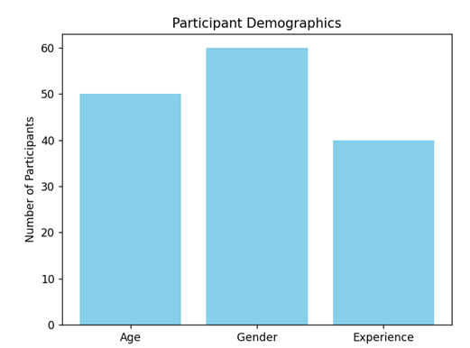
PARTICIPANT SELECTION CRITERIA
Ensured demographic diversity by selecting individuals from various age groups, genders, and levels of technological skills.
Participants possessed different levels of experience with AR interfaces, ensuring inclusion of both beginners and advanced users.
Upheld ethical standards by obtaining consent and providing comprehensive information about the research goals and data gathering techniques.

Slide 13
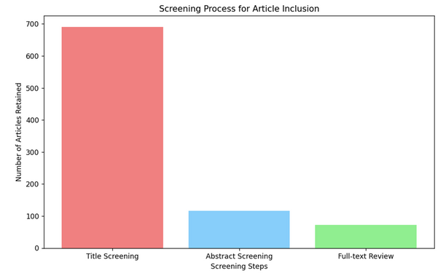

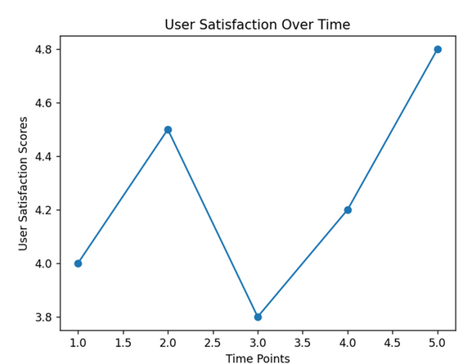
RESULTS
Positive user responses observed in head-up augmented reality interfaces for crash warning systems.
Increased situational awareness and quicker response times demonstrated.
Challenges in real-virtual interaction highlighted varying degrees of comfort and immersion.
Usability testing provided valuable input for mobile AR navigation systems.
Insights from literature review and HCI workshop emphasized transformative potential of AR in transportation.

Slide 14
AUGMENTED REALITY IN HCI: CURRENT STATE
Recent developments: AR interfaces have become popular as a result of technological progress, providing immersive experiences through the integration of digital content with the physical environment.
Possible uses:
Gaming and Entertainment: AR interfaces transform conventional entertainment by merging digital components with the real world.
Education: Augmented Reality improves learning by providing interactive visualizations and simulations.
Healthcare: Augmented Reality helps in medical education, patient treatment, and guiding surgeries, enhancing accuracy and lowering dangers.
AR is utilized in industry for maintenance, repair, and training functions, leading to increased efficiency and decreased mistakes.
IKEA's augmented reality furniture application enables users to see how furniture will look in their homes before buying, improving online shopping and minimizing returns.
Assessments: Typically, users have a favorable attitude towards AR interfaces, enjoying their engaging quality. Nevertheless, obstacles like device restrictions and usability problems continue to exist.

Slide 15


THE FUTURE OF AUGMENTED REALITY IN HCI
Integration:
AR integrated seamlessly into daily life.
Adoption of AR glasses/contact lenses to replace traditional screens.
Spatial computing and machine learning advancements to enhance AR capabilities.
Breakthroughs:
Focus on higher resolutions, wider field views, and improved transparency in AR glasses.
Advancements in computer vision and sensor tech for accurate real-time tracking.
AR glasses produced by 3D printers, merging AR with eco-friendly practices.
Opportunities:
AR's implications for UX design across gaming, education, healthcare, and industry.
Consideration of user context, task requirements, and ethical considerations.
AR to provide more natural interactions, but privacy and security concerns need addressing.

Slide 16



CHALLENGES AND OPPORTUNITIES
UNRESOLVED CHALLENGES IN AR HCI.
POTENTIAL OPPORTUNITIES FOR IMPROVEMENT.
ETHICAL IMPLICATIONS IN AR INTERACTIONS

Slide 17
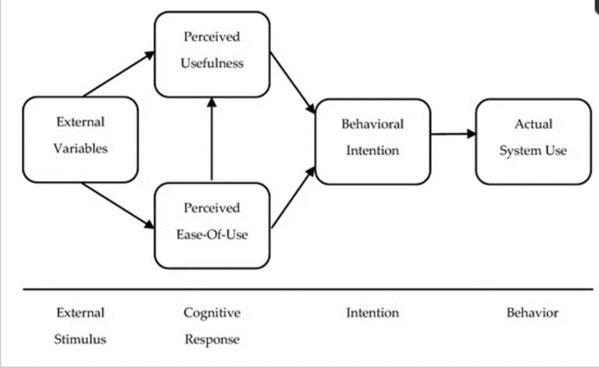
UNRESOLVED CHALLENGES IN AR HCI
Calibrating AR devices is challenging and impacts the precision of digital information placement due to inconsistency.
AR systems face challenges in adjusting to various environmental conditions, which affects their usability.
Device restrictions in terms of field of vision, weight, and battery longevity present obstacles to achieving enduring, pleasant user experiences.

Slide 18

POTENTIAL OPPORTUNITIES FOR IMPROVEMENT
Advanced methods for calibration: Combining computer vision and machine learning can improve the accuracy of calibration.
Solutions for Environmental Adaptability: Enhanced usability can be achieved by including environmental sensors and context-sensitive algorithms.
Investments in improved displays, lighter materials, and extended battery life can overcome device limitations for wearable technology advancements.

Slide 19
ETHICAL IMPLICATIONS IN AR INTERACTIONS
Privacy Protection: Implementing strong privacy measures and user consent protocols is essential.
Responsible Data Usage: Clear guidelines for data usage and following data protection laws are crucial.
Inclusive Design and Accessibility: Prioritizing inclusive design principles ensures accessibility for diverse users.

Slide 20




CONCLUSION
Augmented Reality (AR) interfaces offer immersive experiences bridging the digital and physical realms, impacting various domains like gaming, education, healthcare, and industry.
Despite advancements, challenges like calibration issues, usability concerns, and ethical considerations persist, requiring continuous research and innovation.
The integration of AR into daily life is expected to grow, with potential breakthroughs in display technology and user interaction paradigms.
To leverage the full potential of AR in Human-Computer Interaction (HCI), emphasis on inclusive design principles, accessibility, and ethical data usage is essential.
The future of AR in HCI promises seamless, immersive, and enriching user interactions, with designers leading the way in shaping user-centric experiences.

Slide 21
REFRENCES
Tech, H.K.V. et al. (2013) Exploring head-up augmented reality interfaces for crash warning systems: Proceedings of the 5th International Conference on Automotive user interfaces and interactive vehicular applications, ACM Other conferences. Available at: https://dl.acm.org/doi/abs/10.1145/2516540.2516566?casa_token=getVkQvSyPs AAAAA%3AIkWvdWXvKz9jaa3T_v5cUh16BLHJrCb9g63MV4icdgZ5WYLQDAQ 0yKG8zyOXuP3Nua82hgDgjURQw (Accessed: 11 March 2024).
Kim, K., Bruder, G. and Welch, G. (2017) Exploring the effects of observed physicality conflicts on real-virtual human interaction in augmented reality: Proceedings of the 23rd ACM Symposium on Virtual Reality Software and Technology, ACM Conferences. Available at: https://dl.acm.org/doi/abs/10.1145/3139131.3139151 (Accessed: 11 March 2024).
Riegler, A., Riener, A. and Holzmann, C. (2021) Augmented reality for future mobility: Insights from a literature review and HCI Workshop, De Gruyter. Available at: https://www.degruyter.com/document/doi/10.1515/icom-2021- 0029/html (Accessed: 11 March 2024). [4] S. Hu, L. Rong, J. Han, D. Zhang and W. Jiang, "The Effects of Interaction Mode and Individual Differences on Usability and User Experience of Mobile Augmented Reality Navigation," in IEEE Access, vol. 11, pp. 41783-41795, 2023, doi: 10.1109/ACCESS.2023.3271522. keywords: {Navigation;Behavioral sciences;Task analysis;Usability;Emotion recognition;Touch sensitive screens;Three-dimensional displays;Mobile AR navigation;usability;PAD 3D emotional experience;behavior-emotion analysis;difference research;mental cutting ability},
Papakostas C, Troussas C, Krouska A, Sgouropoulou C. Measuring User Experience, Usability and Interactivity of a Personalized Mobile Augmented Reality Training System. Sensors. 2021; 21(11):3888. https://doi.org/10.3390/s21113888 Impact of AR on UX in HCI [6] Dirin A, Laine TH. User Experience in Mobile Augmented Reality: Emotions, Challenges, Opportunities and Best Practices. Computers. 2018; 7(2):33. https://doi.org/10.3390/computers7020033
Bujak, K.R. et al. (2019) Using augmented reality with speech input for non?native children’s language learning, International Journal of Human-Computer Studies. Available at: https://www.sciencedirect.com/science/article/abs/pii/S1071581918303161 (Accessed: 11 March 2024). [8] Choi H, Jeong H, Kim GJ. User Experience of Multi-Mode and Multitasked Extended Reality on Different Mobile Interaction Platforms. Electronics. 2023; 12(6):1457. https://doi.org/10.3390/electronics12061457
Ozturkcan, S. (2020) ‘Service innovation: Using augmented reality in the IKEA place app’, Journal of Information Technology Teaching Cases, 11(1), pp. 8–13. doi:10.1177/2043886920947110.
S. Hu, L. Rong, J. Han, D. Zhang and W. Jiang, "The Effects of Interaction Mode and Individual Differences on Usability and User Experience of Mobile Augmented Reality Navigation," in IEEE Access, vol. 11, pp. 41783-41795, 2023, doi: 10.1109/ACCESS.2023.3271522. keywords: {Navigation;Behavioral sciences;Task analysis;Usability;Emotion recognition;Touch sensitive screens;Three-dimensional displays;Mobile AR navigation;usability;PAD 3D emotional experience;behavior-emotion analysis;difference research;mental cutting ability}, [11] Lamata, P. et al. (2010) Augmented reality for minimally invasive surgery: Overview and some recent advances, IntechOpen. Available at: https://www.intechopen.com/chapters/6760 (Accessed: 11 March 2024). [
Kang, Y. and Han, S. (2014) An alternative method for smartphone input using AR markers, OUP Academic. Available at: https://academic.oup.com/jcde/article/1/3/153/5743378 (Accessed: 11 March 2024). [
José M. Ponzoa, Andrés Gómez, Silvia Villaverde, Vicente Díaz, Technologically empowered? perception and acceptance of AR glasses and 3D printers in new generations of consumers., Technological Forecasting and Social Change, Volume 173, 2021, 121166, ISSN 0040-1625, https://doi.org/10.1016/j.techfore.2021.121166. (https://www.sciencedirect.com/science/article/pii/S0040162521005990) [
Arpit Bhatia, Kasper Hornbæk, Hasti Seifi, Augmenting the feel of real objects: An analysis of haptic augmented reality, International Journal of Human?Computer Studies, Volume 185, 2024, 103244, ISSN 1071-5819, https://doi.org/10.1016/j.ijhcs.2024.103244. (https://www.sciencedirect.com/science/article/pii/S1071581924000284) Impact of AR on UX in HCI
O. Oyebode, F. Alqahtani and R. Orji, "Using Machine Learning and Thematic Analysis Methods to Evaluate Mental Health Apps Based on User Reviews," in IEEE Access, vol. 8, pp. 111141-111158, 2020, doi: 10.1109/ACCESS.2020.3002176. keywords: {Mental health;Sentiment analysis;Support vector machines;Machine learning;Google;Classification algorithms;Machine learning algorithms;Health;machine learning;mental health;mobile apps;sentiment analysis;thematic analysis;user reviews;wellbeing[ analysis;user reviews;wellbeing

Slide 22


THANK YOU

Slide 23

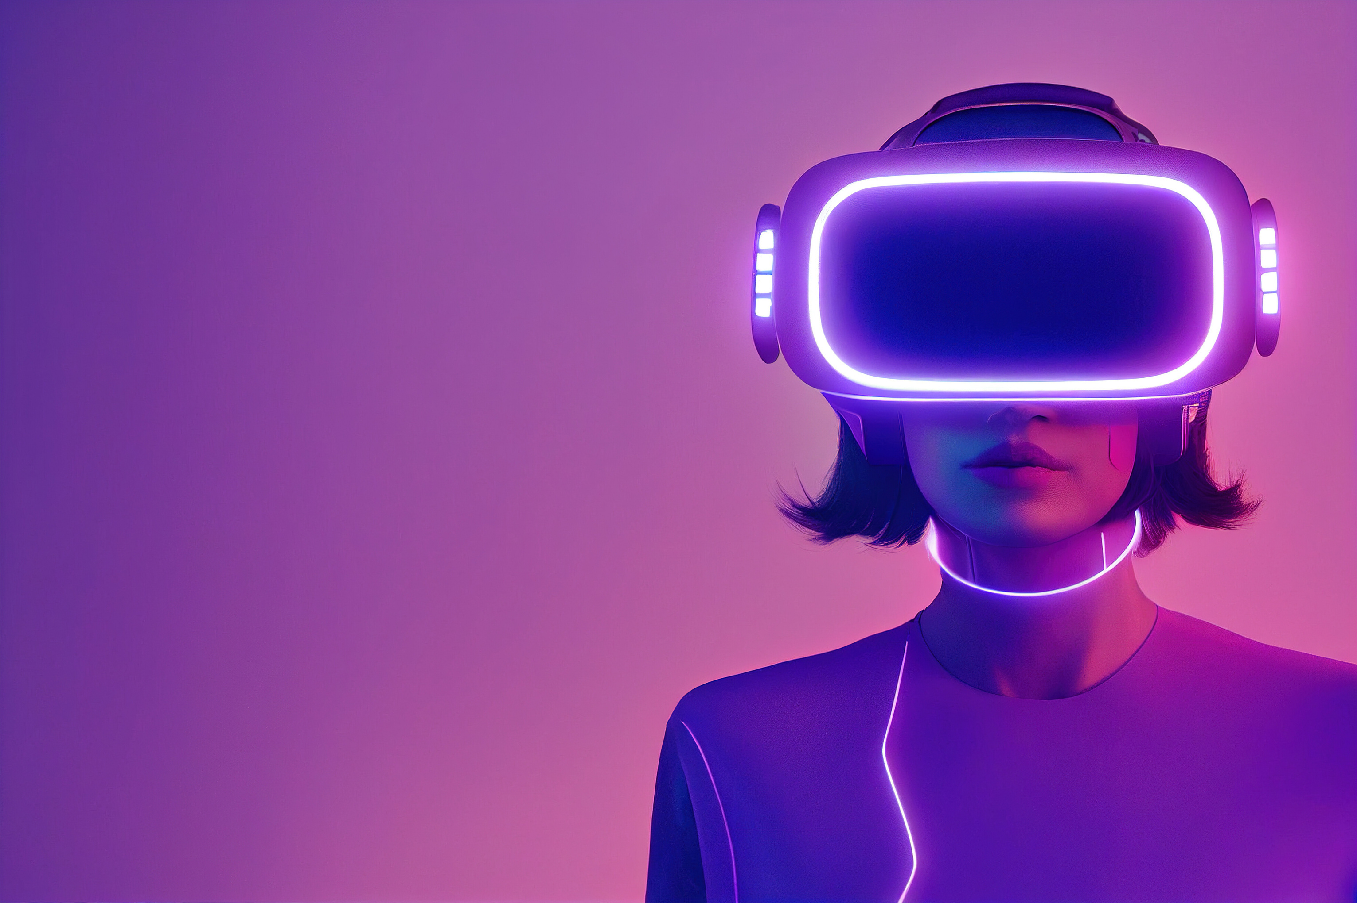
ANY QUESTIONS
?????
Presentation by:
KRUTARTRH GHUGE 0746015
SAMAKSH MONGA 0721348

